Slide 1

WAY TO ENTERPRISE
Advanced Java
VTI ACADEMY
Author: duy.nguyenngoc1@vti.com.vn
March 2020

Slide 2
Agenda
Setup spring tool suite
HelloWorld
A few concepts
3 Layers
Assignments
Copyright © VTI Academy All Rights Reserved

Slide 3
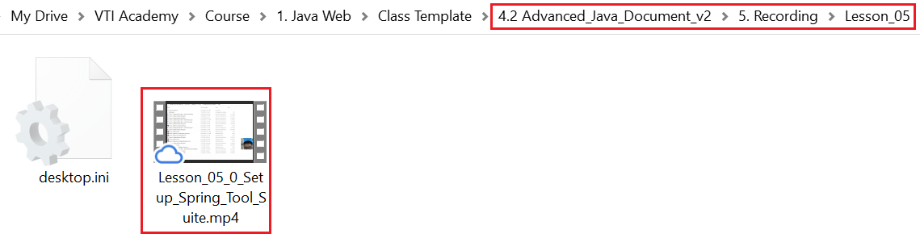
Setup Spring tool suite
View Setup spring tool suite slide

Slide 4
HelloWorld
Step 1: Create Spring Starter Project ➔ Install library
Step 2: Create Controller file
Step 3: Start Server
Step 4: Access API

Slide 5
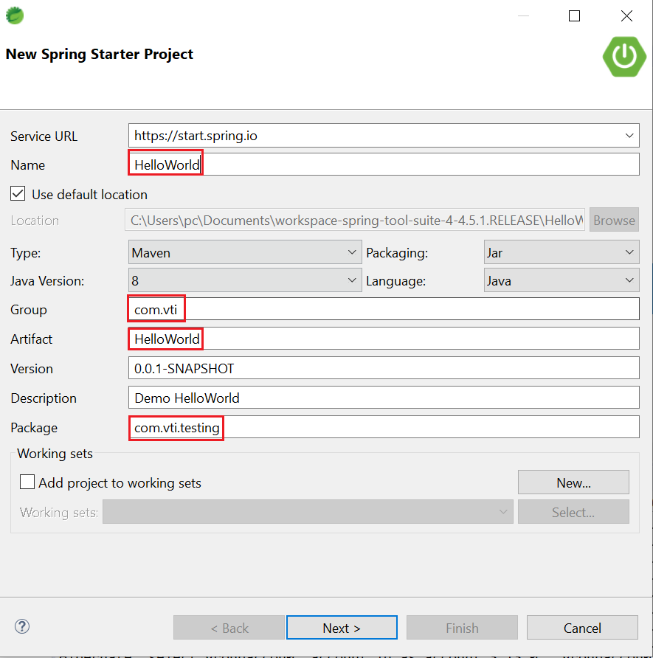
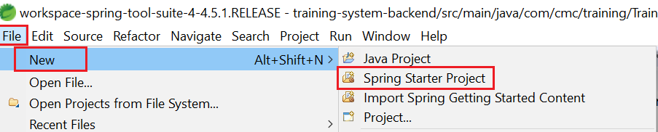
HelloWorld
Step 1: Create Spring Starter Project ➔ Install library

Slide 6
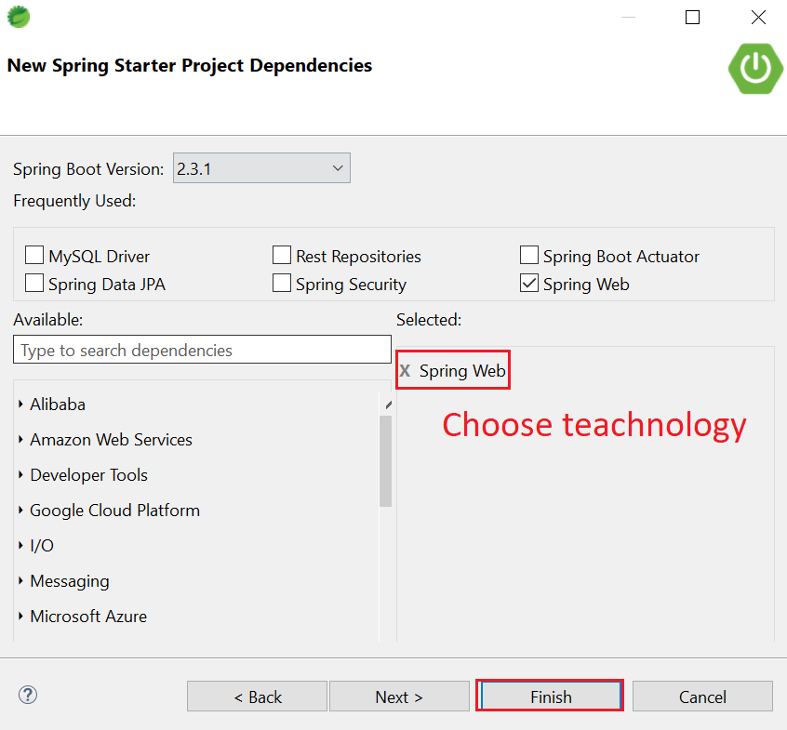
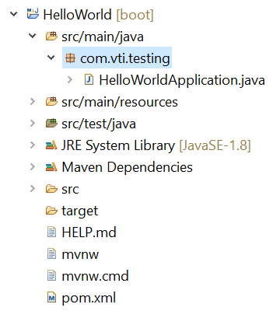
HelloWorld
Source code

Slide 7
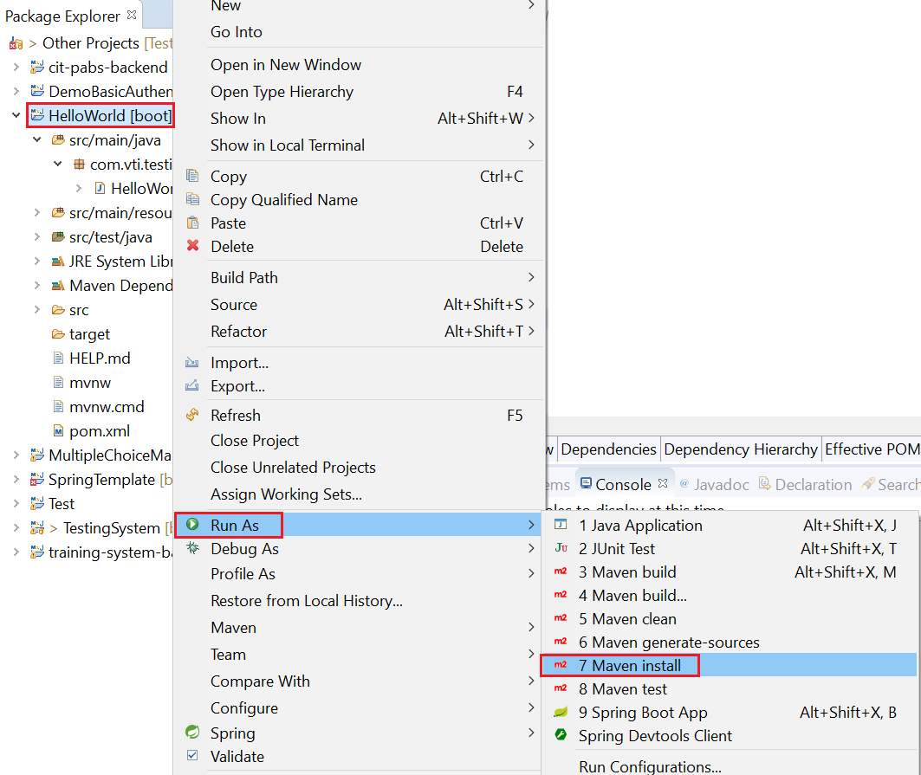
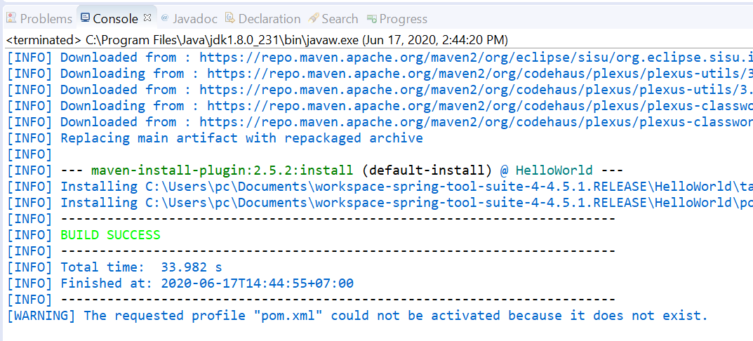
HelloWorld
Install library

Slide 8
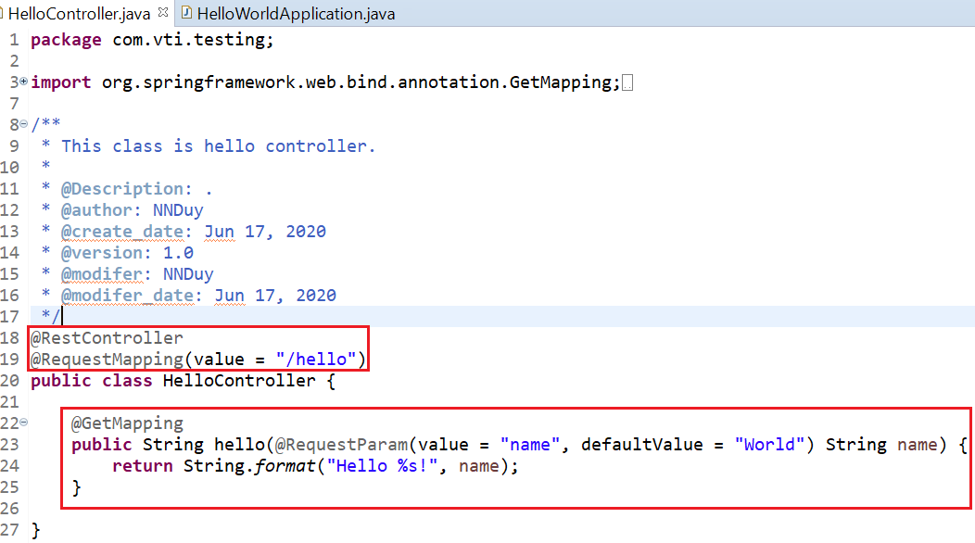
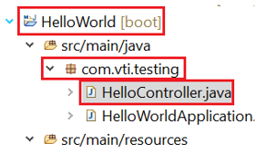
HelloWorld
Step 2: Create Controller file

Slide 9
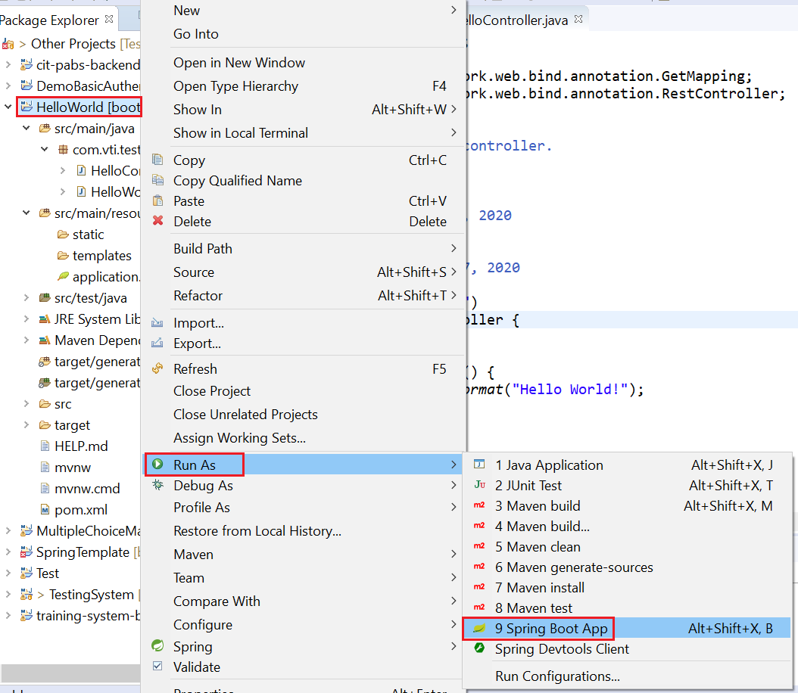
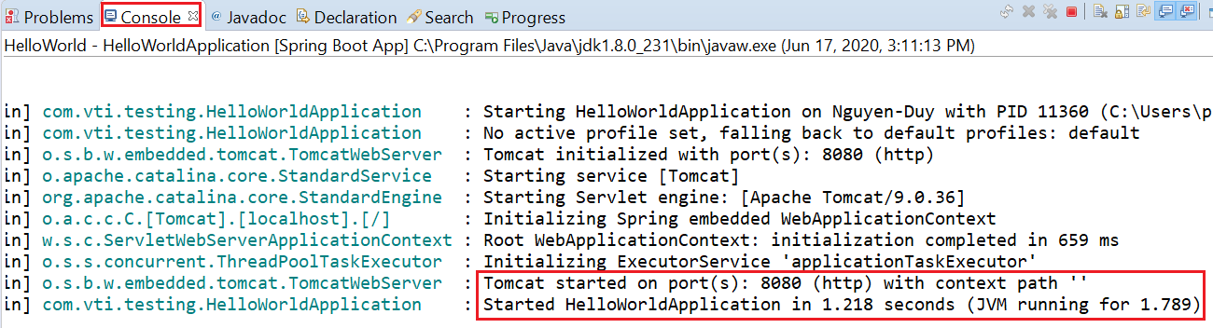
HelloWorld
Step 3: Start Server

Slide 10
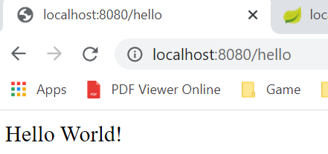
HelloWorld
Step 4: Access API
Tutorial: https://spring.io/quickstart

Slide 11
Testing System Assignments
Self-practice

Slide 12
A few concepts
Web & Web service
JSON & XML
API & Restful API
HTTP

Slide 13
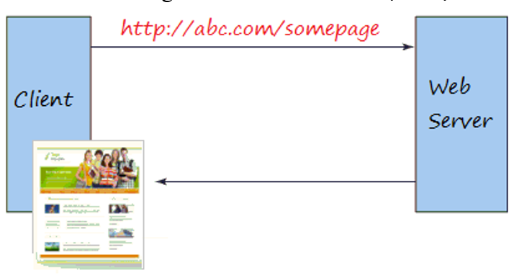
Web & Web Service
Web (Rarely, Old)
Enter the URL and the Brower returns a web page that the user can read
Ex: JSP & Servlet, Spring MVC
Web

Slide 14
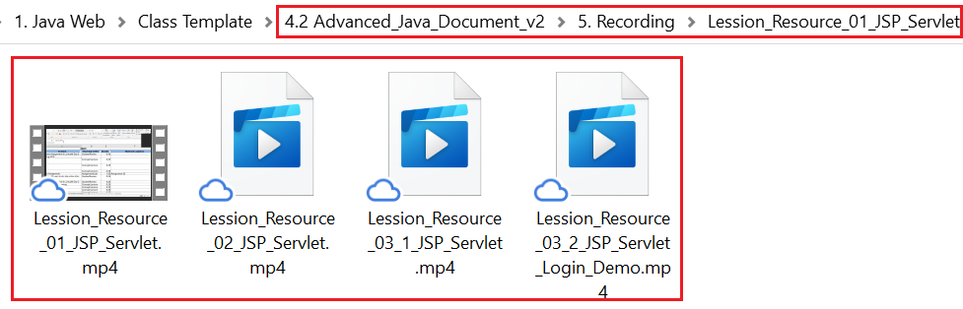
Web & Web Service
JSP & Servlet

Slide 15
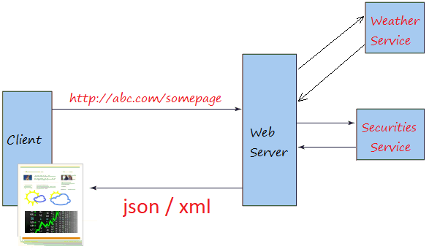
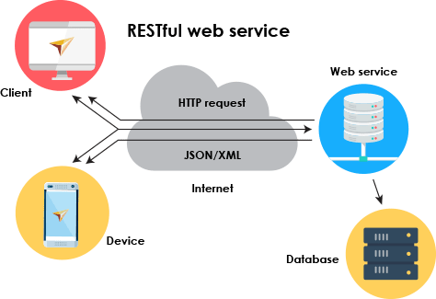
Web & Web Service
Web service
Usually provide raw and confusing information for most users (usually return in JSON, XML)
The backend can provide services to multiple frontend types (ex: mobile, web, tv, ...)
Web service
Multiple frontend types

Slide 16
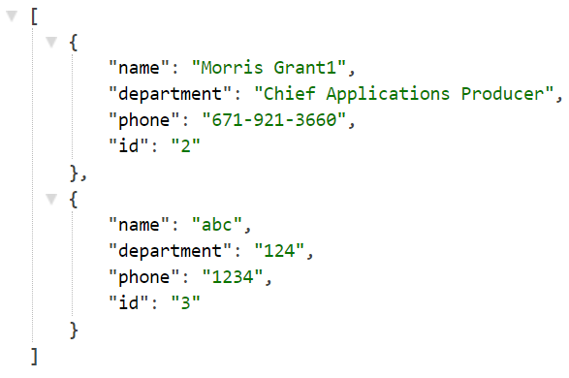
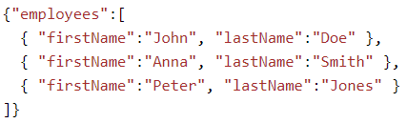
JSON & XML
JSON (JavaScript Object Notation)
Doesn't use the tag ➔ shorter than XML ➔ quicker loading
Using for sending data between 2 application
JSON

Slide 17
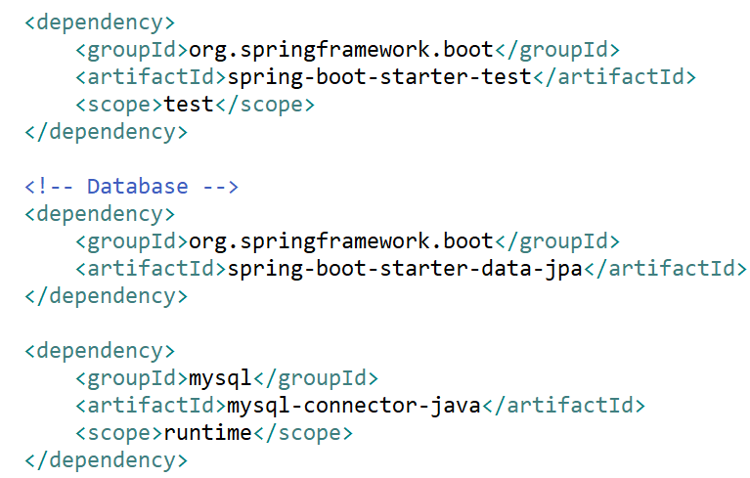
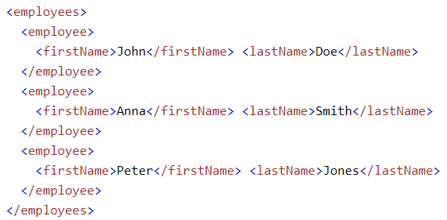
JSON & XML
XML
Using for application configuration, html, css, ...
XML

Slide 18
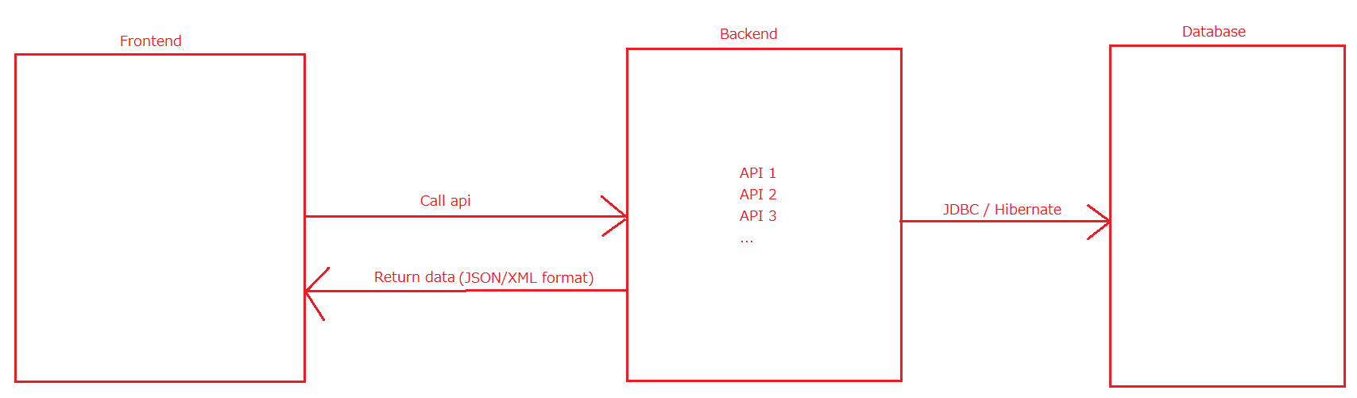
API & Restful API
API (Application Programming Interface)
Using for transfer data between 2 application

Slide 19
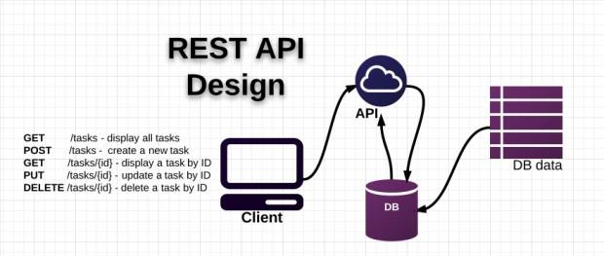
API & Restful API
Restful API
is a standard used in designing APIs for web applications to manage resources

Slide 20

API & Restful API
Restful API design principles
1. Use plural nouns, don't use verbs
2. Use HTTP request method to separate User Action
GET: for reading data
POST: for creating data
PUT: for updating data
DELETE: for removing data

Slide 21

API & Restful API
Restful API design principles
3. Use sub-resources
4. Providing Paging, Sort, Filter, field Choosing

Slide 22
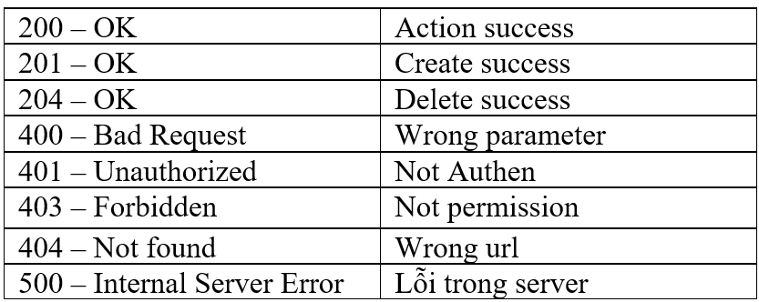
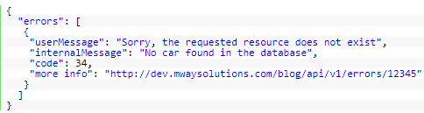
API & Restful API
Restful API design principles
5. Providing version
6. Handling Exception
Common Error

Slide 23
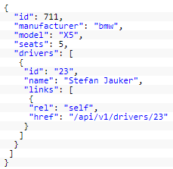
API & Restful API
Restful API design principles
7. HATEOAS (Hypermedia as the Engine of Application State)

Slide 24
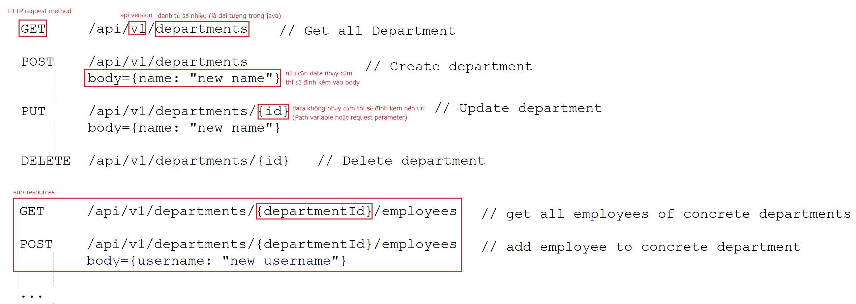
API & Restful API
Restful API design principles
Example
Next Lesson: Designing for paging, sort, filter, handling error, HATEOAS

Slide 25
API & Restful API
Restful API design principles
References
https://www.laurencegellert.com/2016/08/webservice-api-design-tips-correct-pagination-and-exposing-deleted-rows/
https://docs.microsoft.com/en-us/azure/architecture/best-practices/api-design

Slide 26
Testing System Assignments
Self-practice

Slide 27
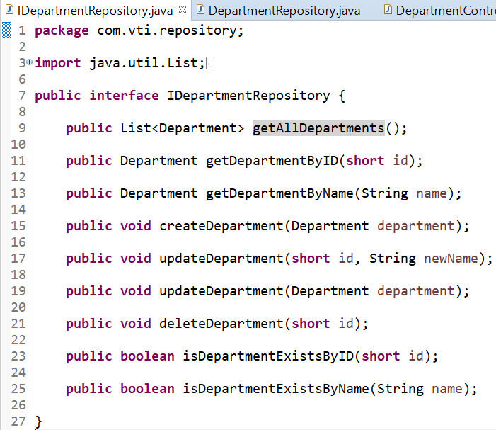
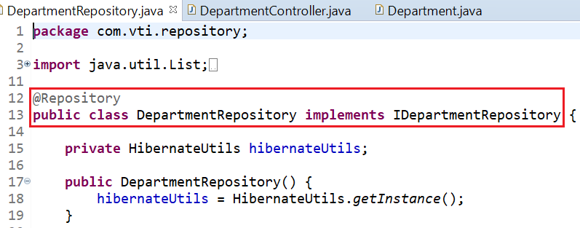
API & Restful API
Implement Restful API with 3 Layer Spring boot
Repository

Slide 28
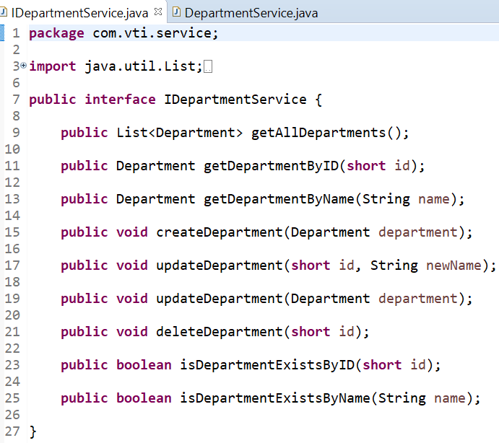
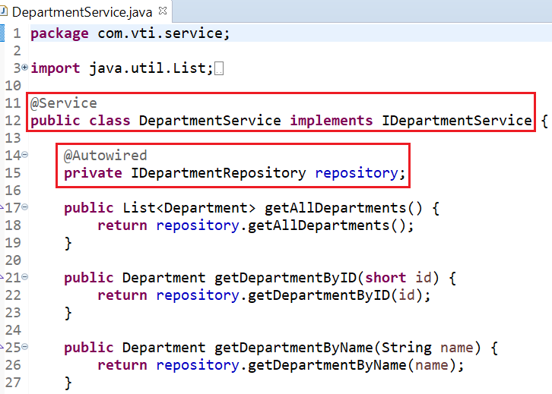
API & Restful API
Service

Slide 29
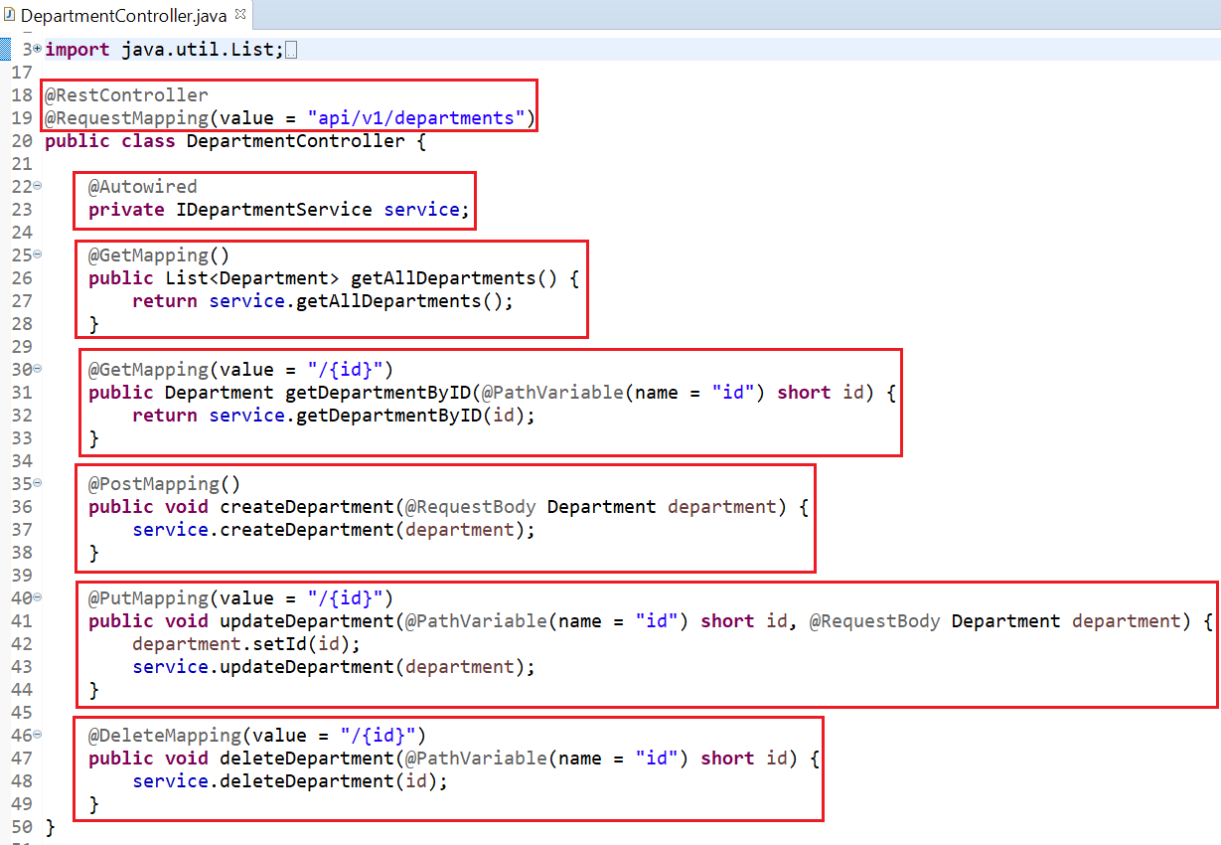
API & Restful API
Controller

Slide 30
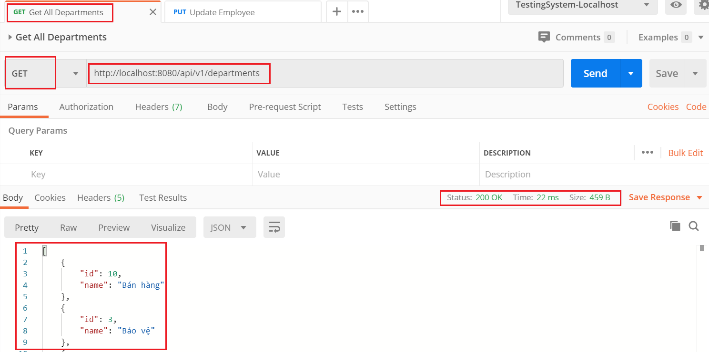
API & Restful API
Test (postman)
https://www.postman.com/downloads
Get all

Slide 31
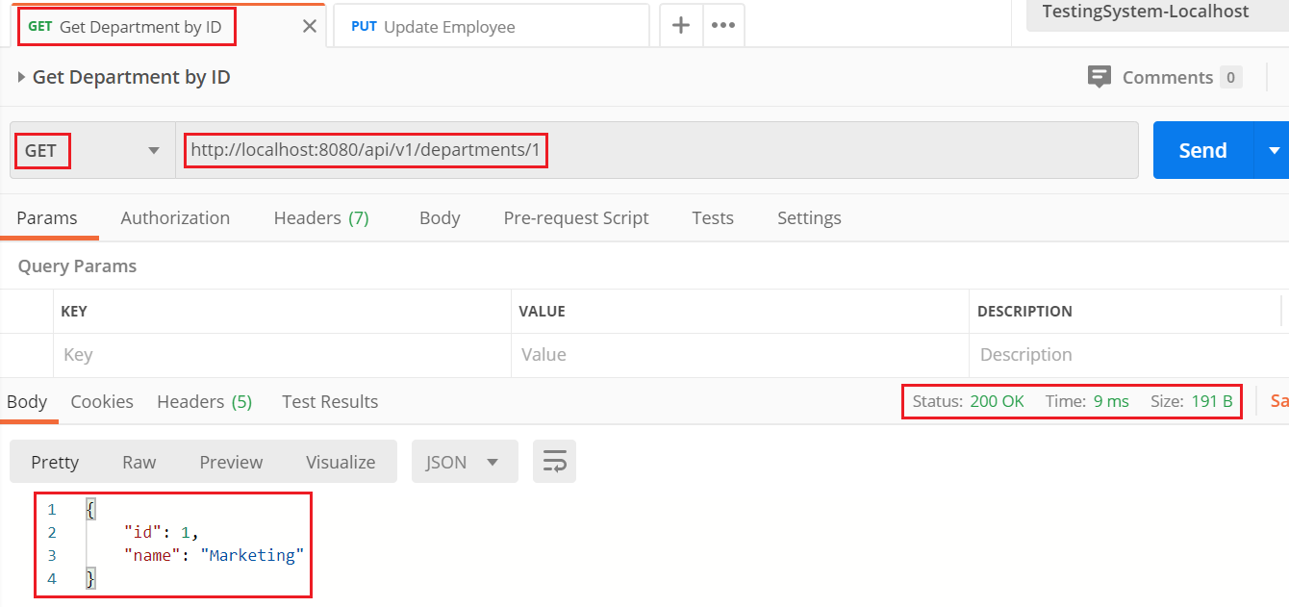
API & Restful API
Get by ID

Slide 32
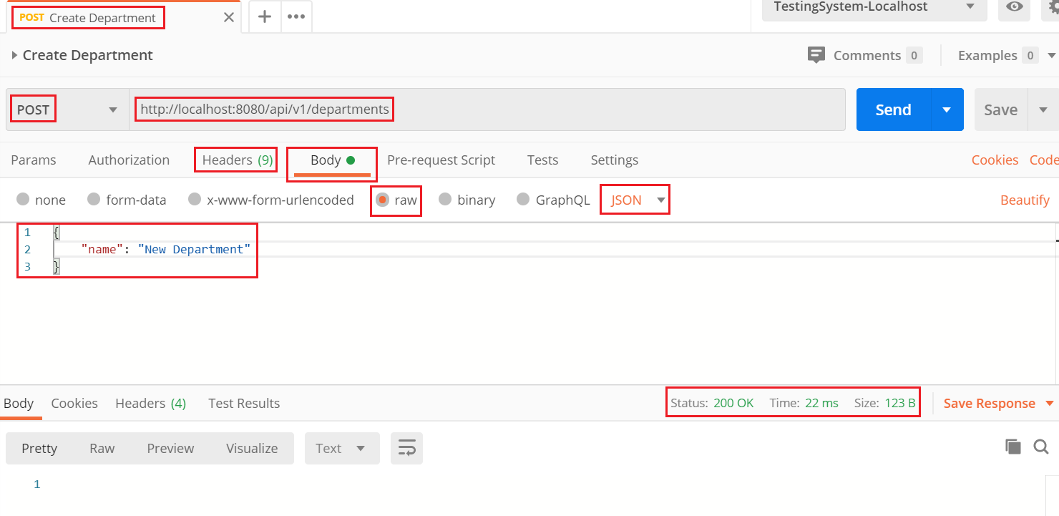
API & Restful API
Create

Slide 33
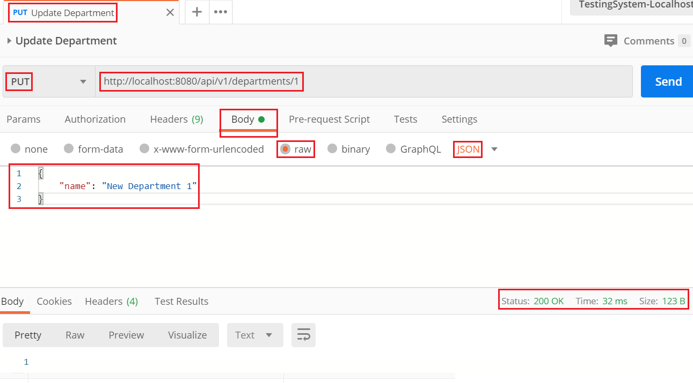
API & Restful API
Update

Slide 34
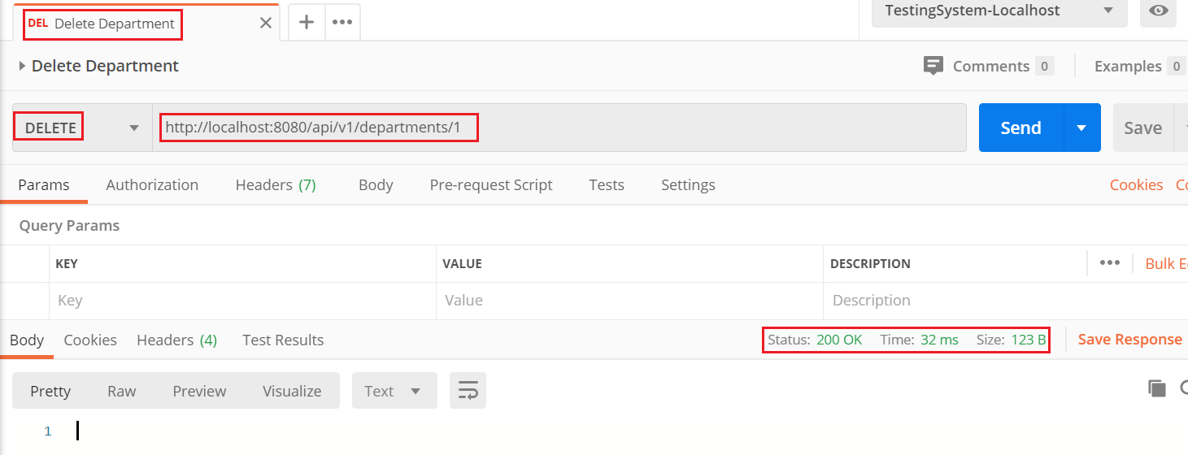
API & Restful API
Delete

Slide 35
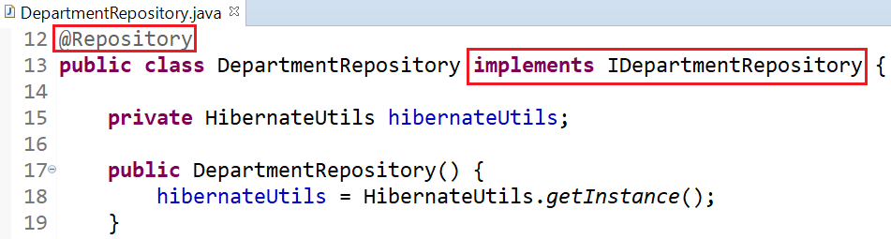
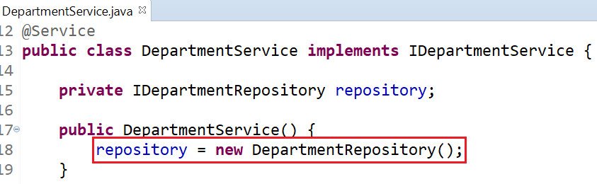
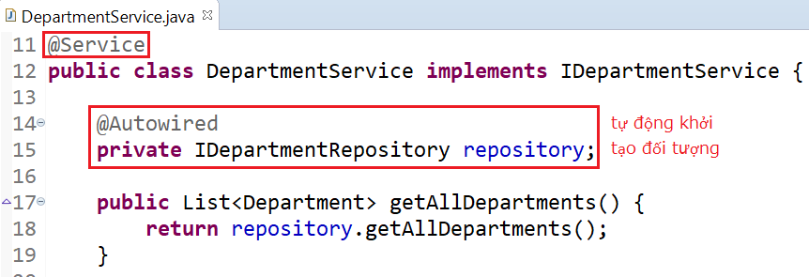
API & Restful API
Explain
@Autowired

Slide 36
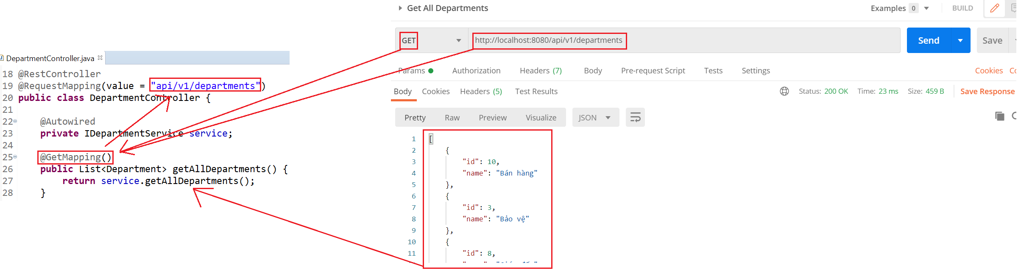
API & Restful API
@GetMapping & URL

Slide 37
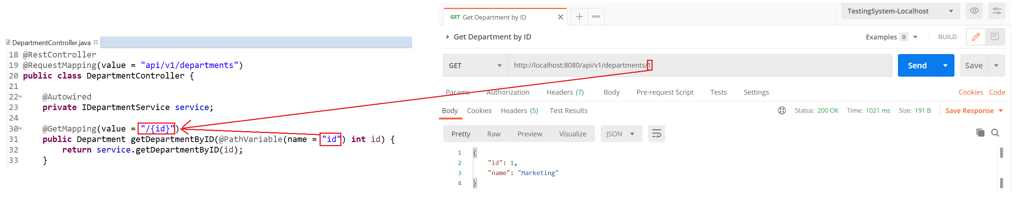
API & Restful API
@PathVariable

Slide 38
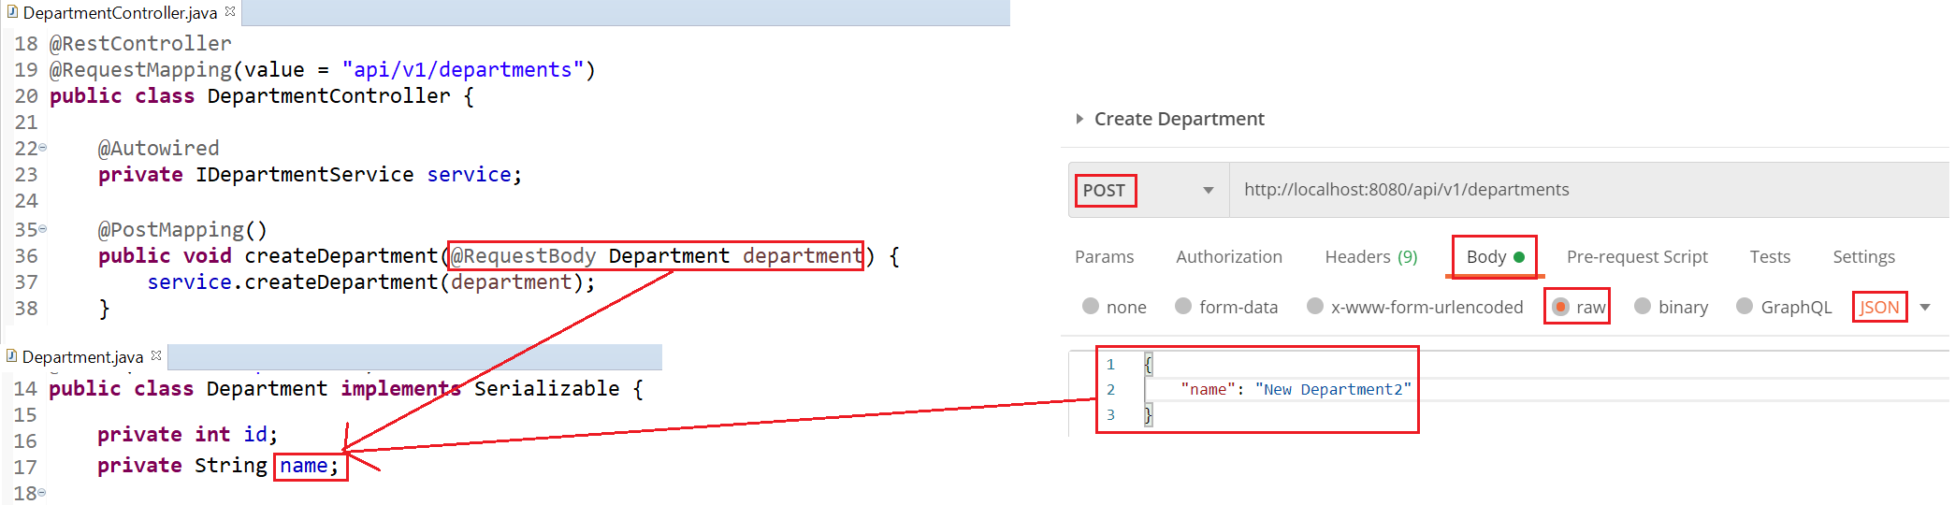
API & Restful API
@RequestBody

Slide 39
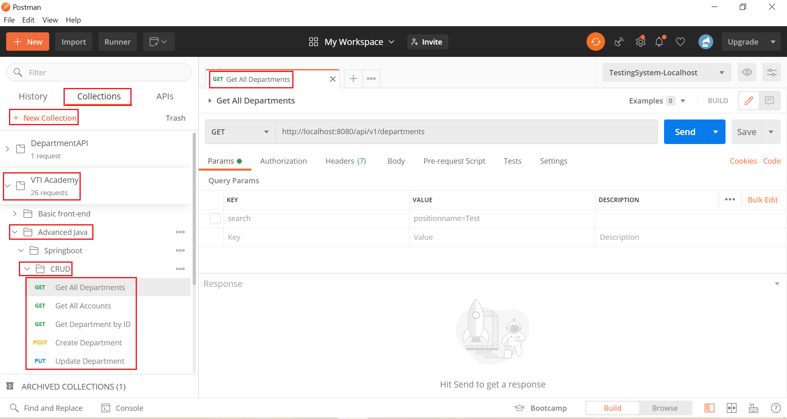
API & Restful API
Postman Organization

Slide 40
API & Restful API
Reference: https://spring.io/guides/gs/rest-service/

Slide 41
Testing System Assignments
Self-practice

Slide 42
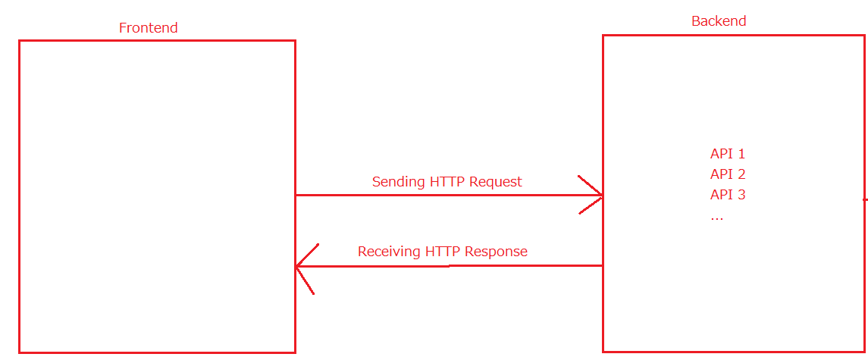
HTTP
HTTP Request
Header (cookie, Authorization,…)
Method (GET, POST, PUT, DELETE, ...)
URL & Body
HTTP Response
Header
Status Code
URL & Body

Slide 43
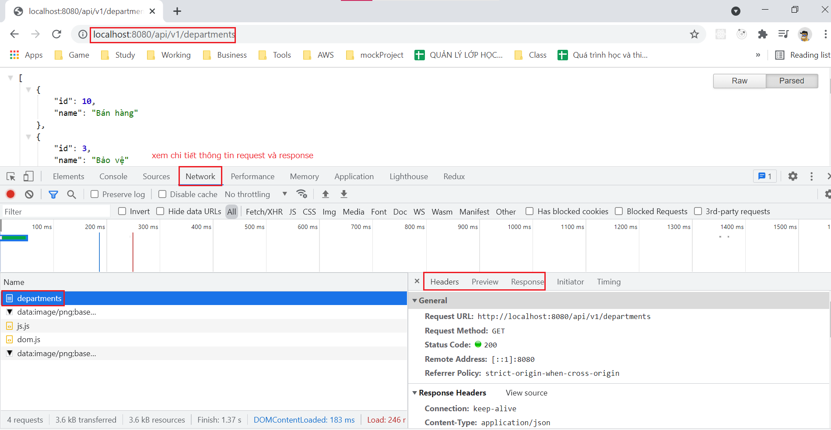
HTTP

Slide 44
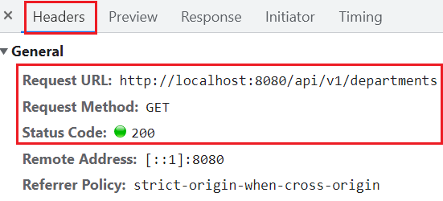
HTTP
HTTP Request Method
GET: Get resource
POST: create resource
PUT: update resource
DELTE: delete resource
Request

Slide 45
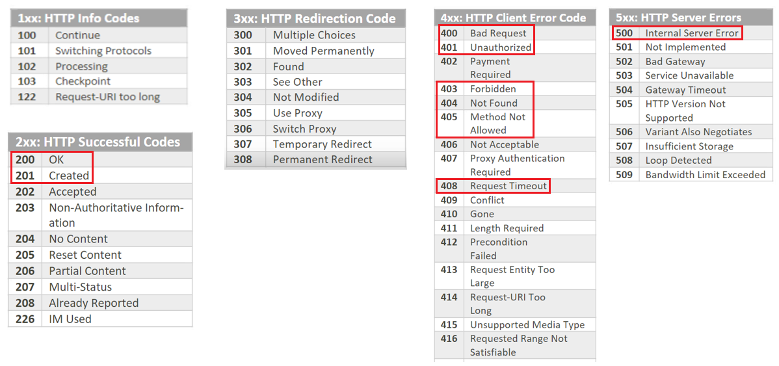
HTTP
HTTP Response Status Code

Slide 46
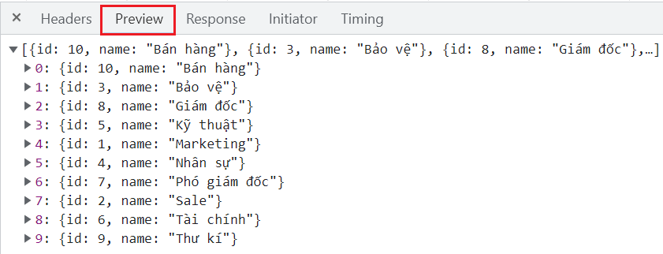
HTTP
Response Data

Slide 47
Testing System Assignments
Self-practice

Slide 48
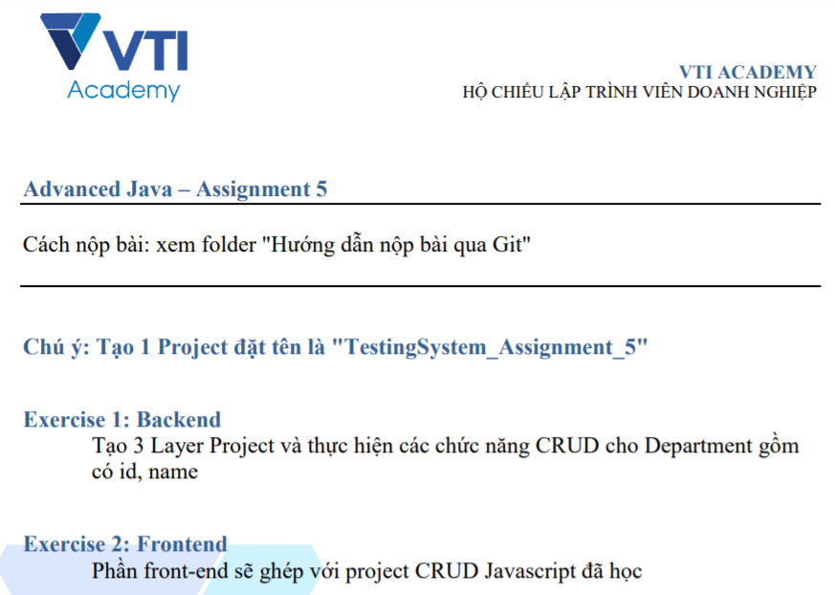
Testing System Assignments

Slide 49
Reference
https://www.baeldung.com
https://spring.io/projects/spring-boot
https://spring.io/guides#getting-started-guides

Slide 50
Q & A
Copyright © VTI Academy All Rights Reserved

